Slide 1

Lipid-Lator
By: Team Triple J
(Jessica Sok, Jose Moreno, & Joseph Tsegaye)
Notes:
Link to Online Version:
https://docs.google.com/presentation/d/1Z9UdsIVnwMSKADYztVWjDjVWSHtoW0pGgXbAKDrtyXU/edit?usp=sharing

Slide 2
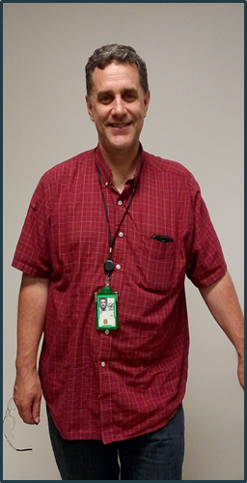
Lipid-Lator
Client: Dr. Jon Rees
Part-time Chemistry Faculty
Research Chemist at the CDC
Request: Develop an android application to compute the molar mass value of lipid ions without the need of any internet.
Why: To use the app daily for research at the CDC.
Motivation: To develop and learn

Slide 3
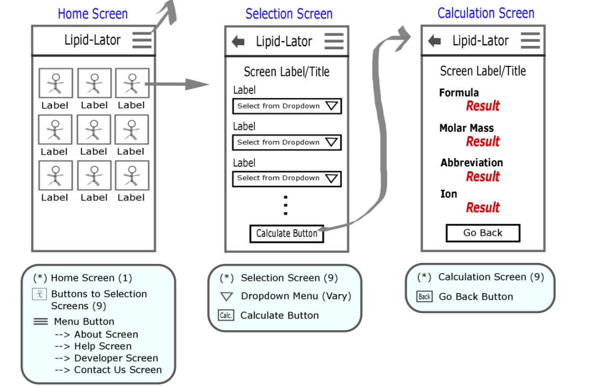
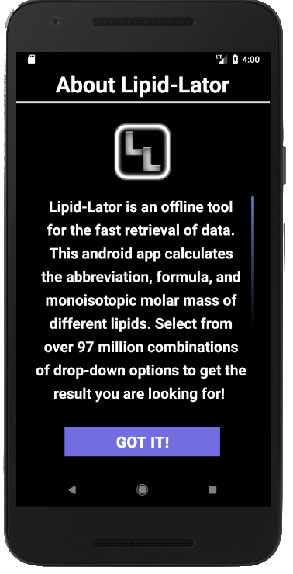
Initial Idea....

Slide 4
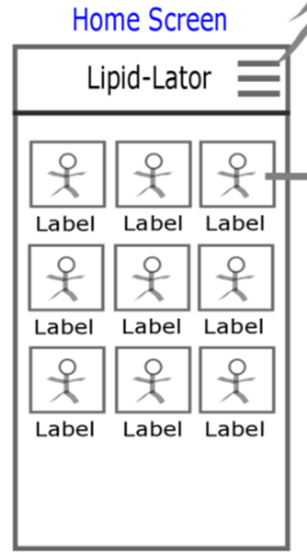
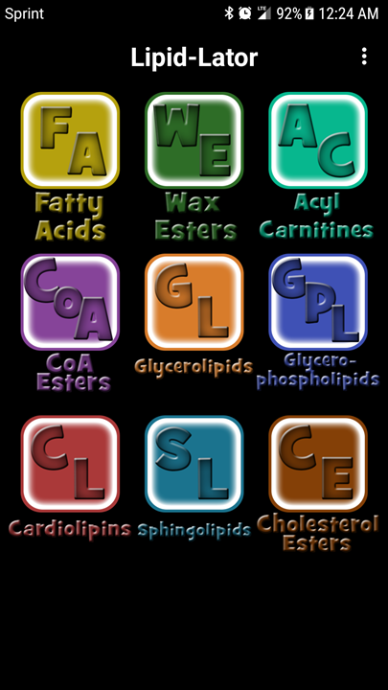
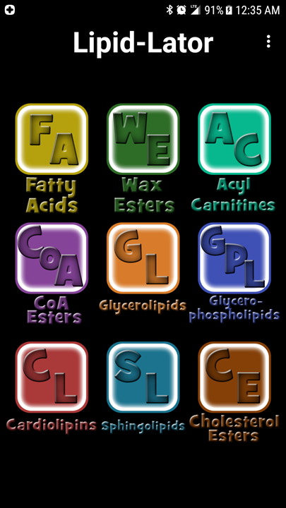

Slide 5
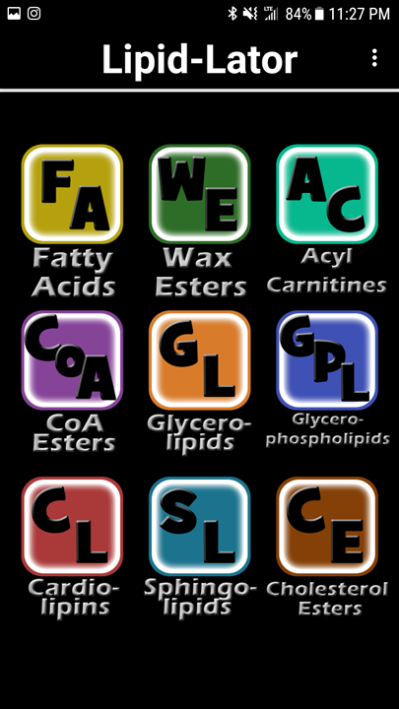

Slide 6
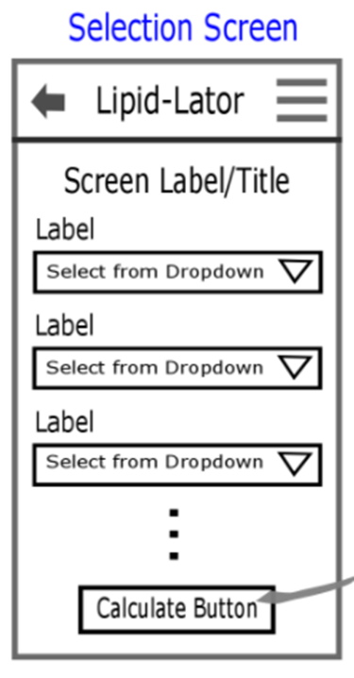
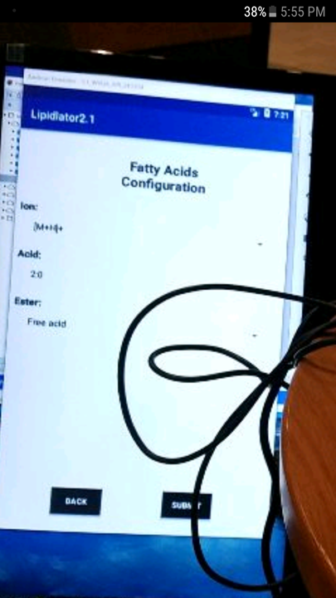
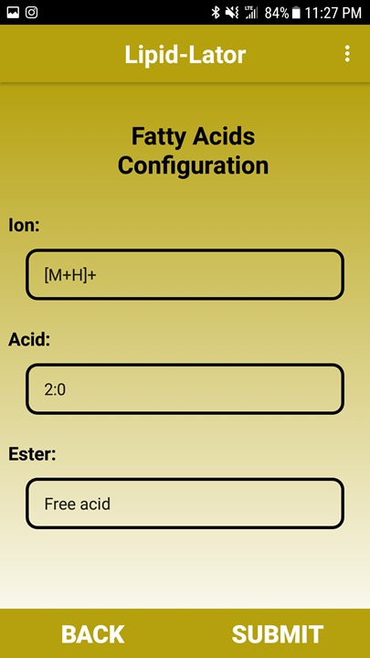

Slide 7
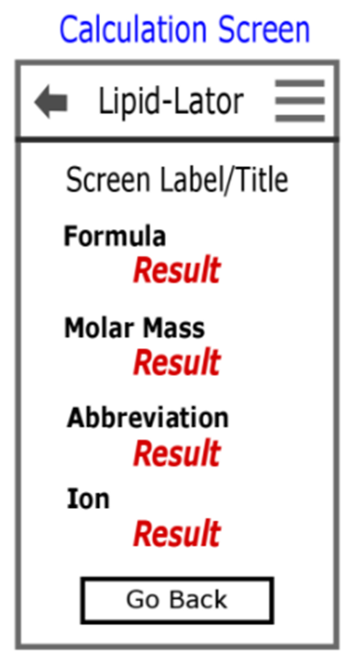
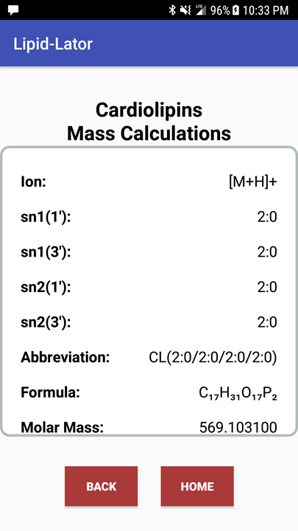
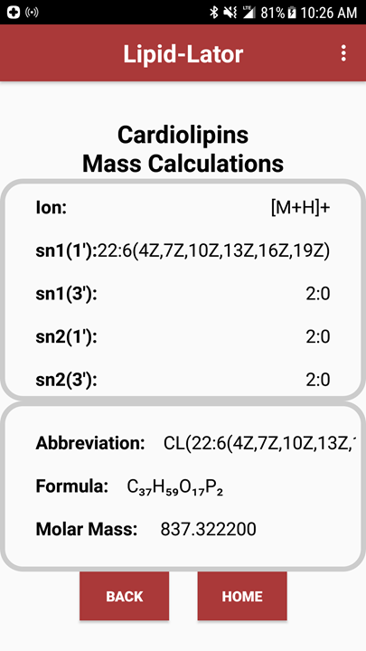

Slide 8
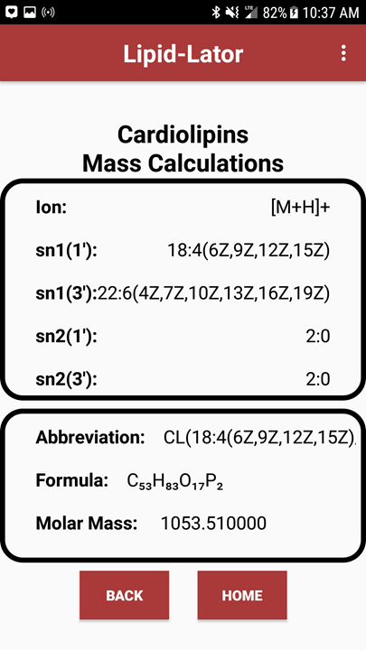
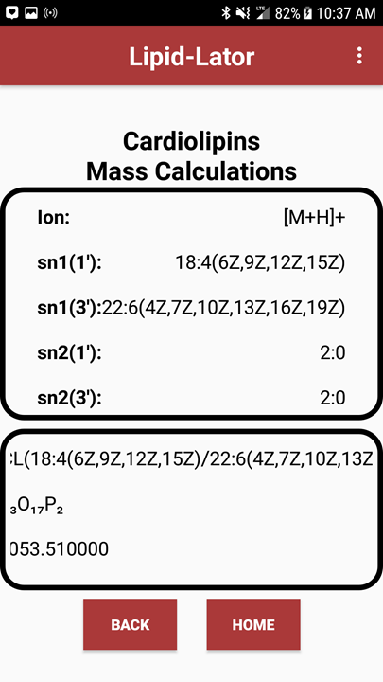
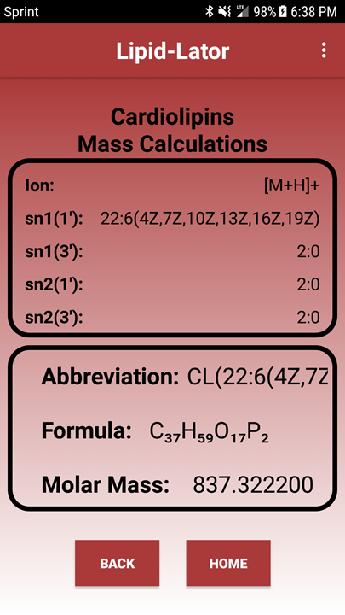

Slide 9
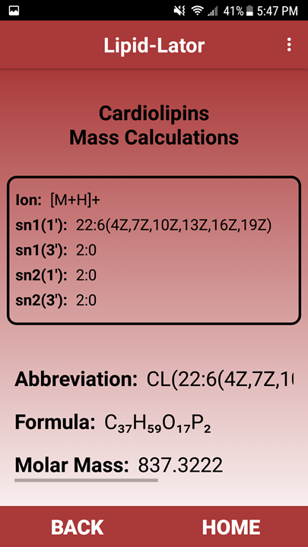

Slide 10
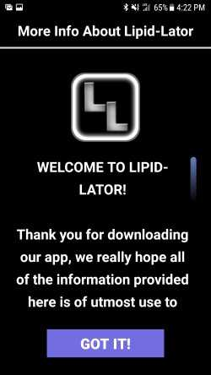
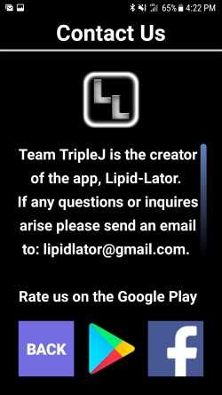
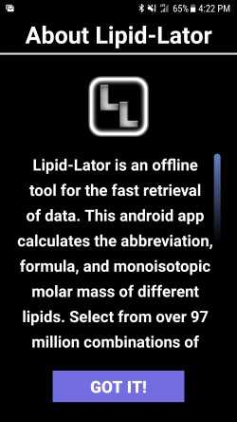

Slide 11
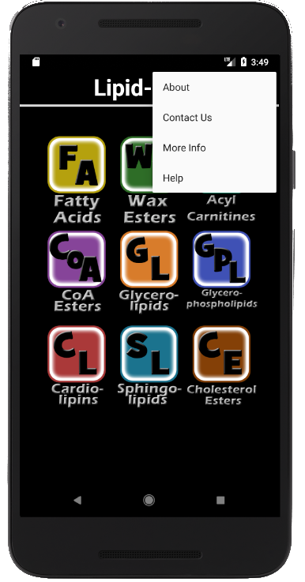
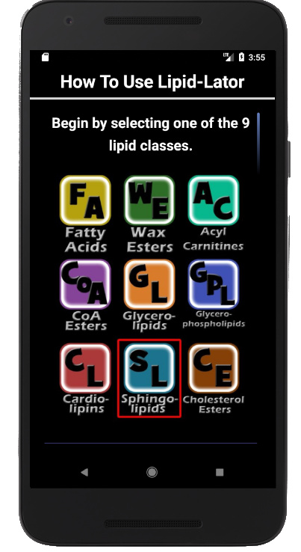
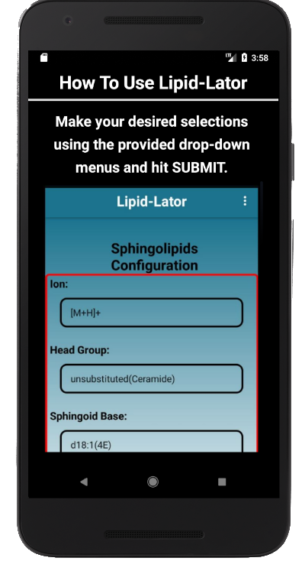
U I
S N
E S S
R T T
E R
H P U
E C
L B T
P Y I
O
S N
T S
E
P

Slide 12
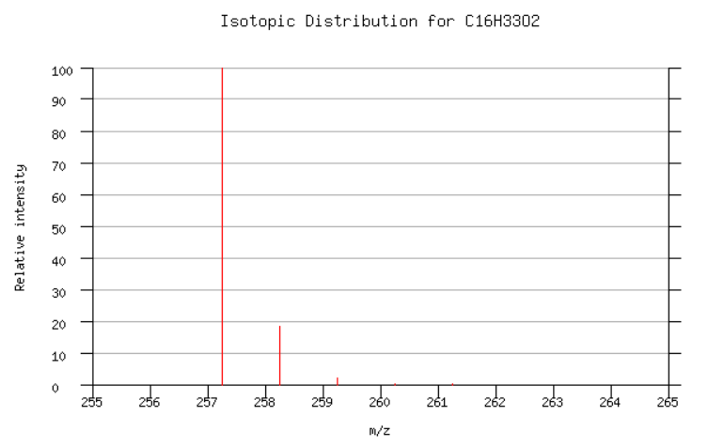
What’s Accomplished + New Features
All requirements were met
No known issues
Main future feature that can be implemented is the Isotopic Distribution Chart

Slide 13
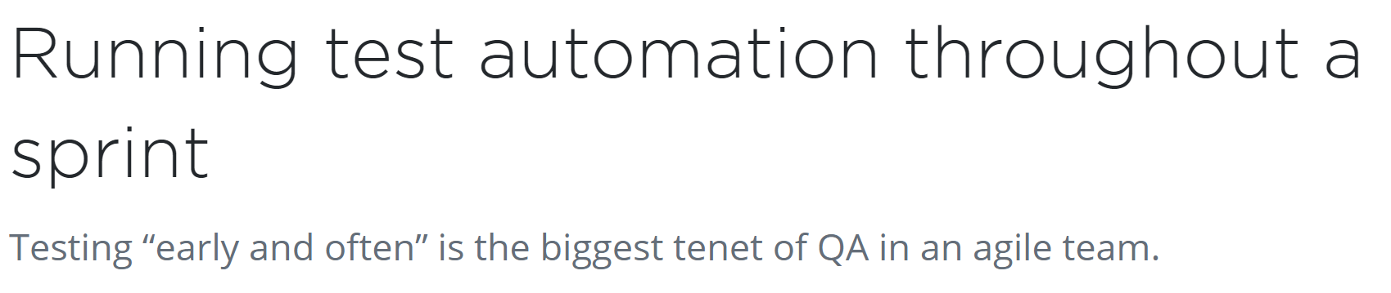
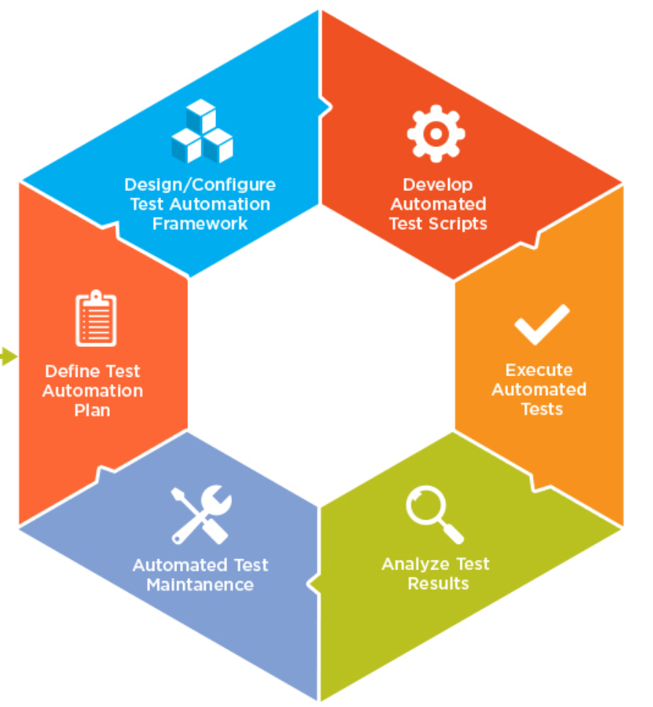
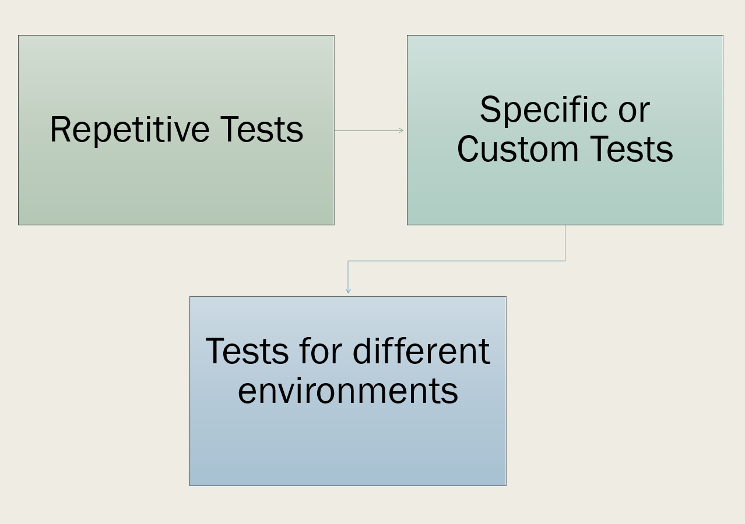
Automated Testing Approach
Notes:
Update of automated testing approach
Report code coverage of unit tests
User testing plan & survey
User testing results and actions taken
Final plan for STARS/CREATE event

Slide 14
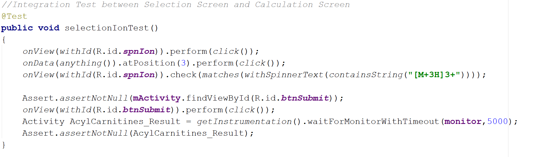
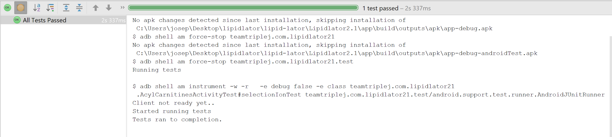
Code Coverage of Unit Tests

Slide 15
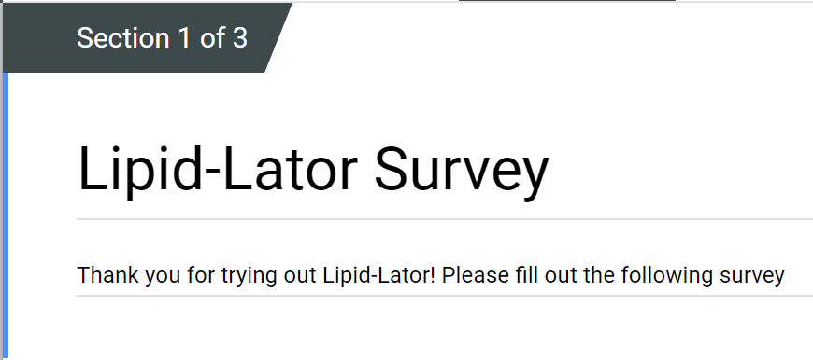
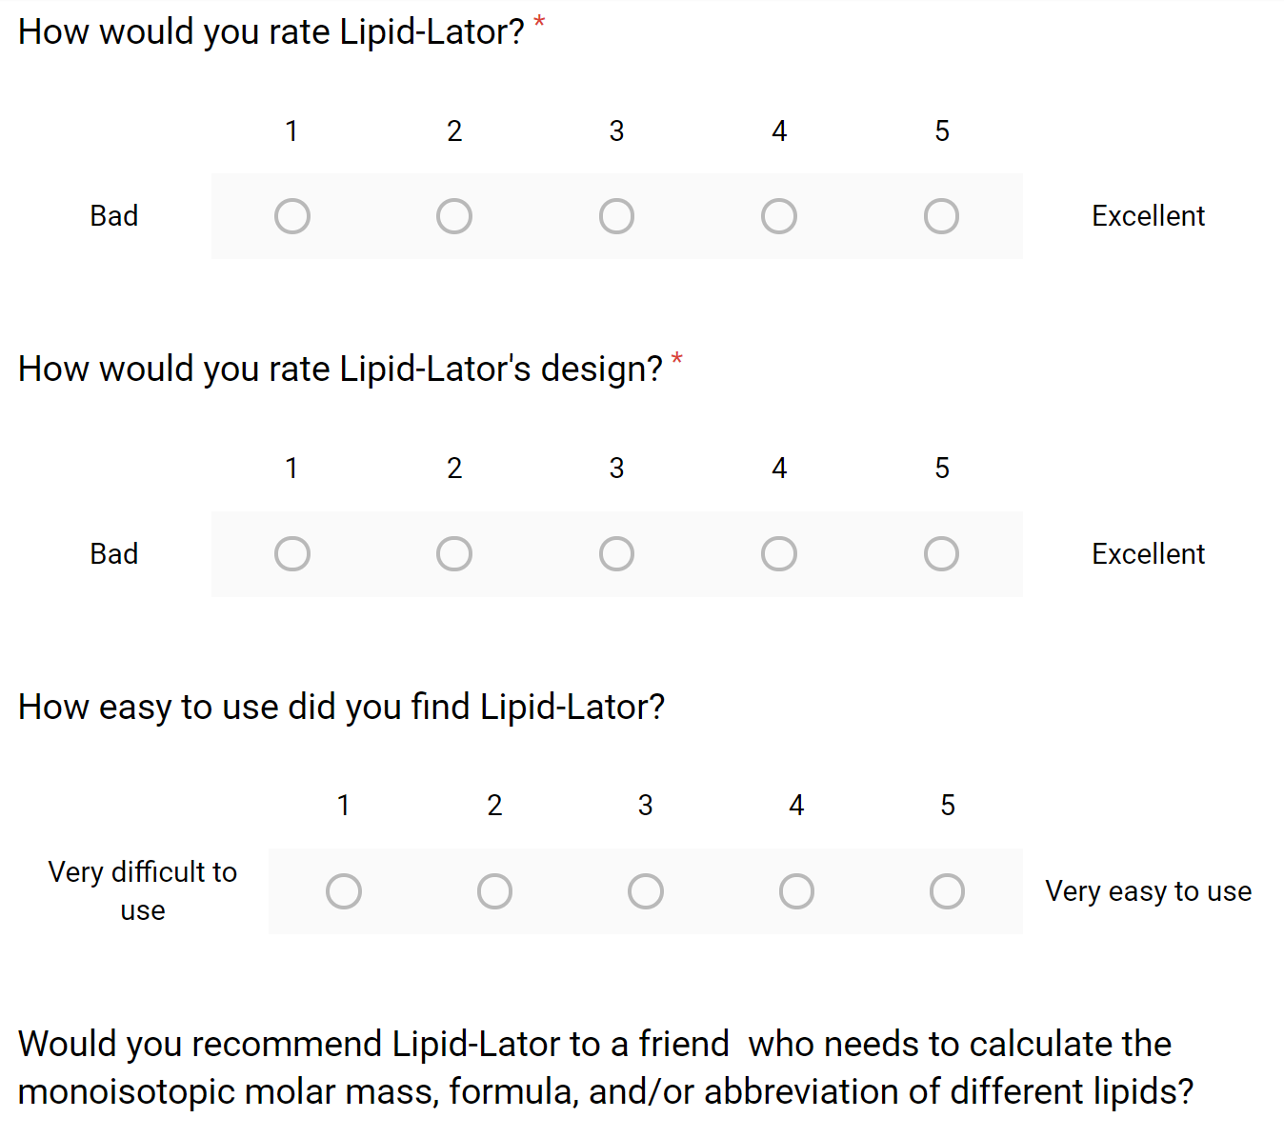
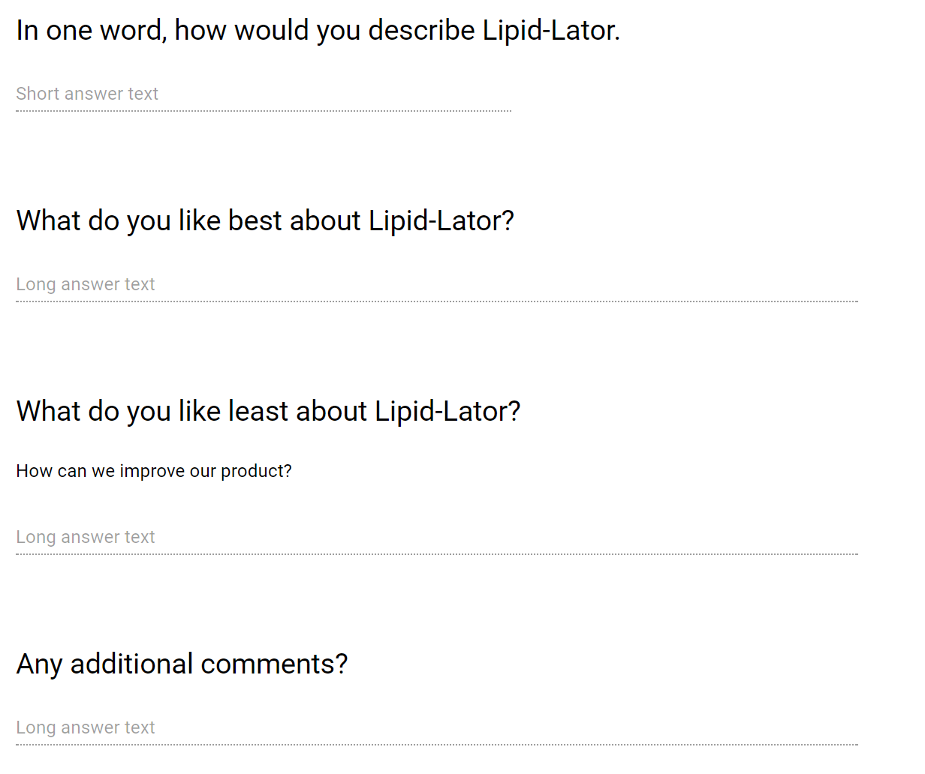
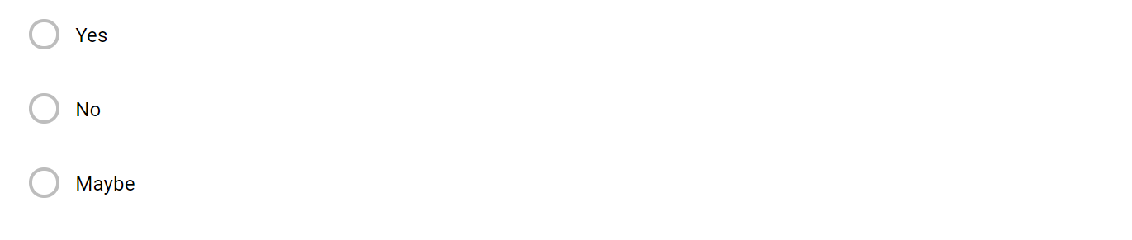

Slide 16
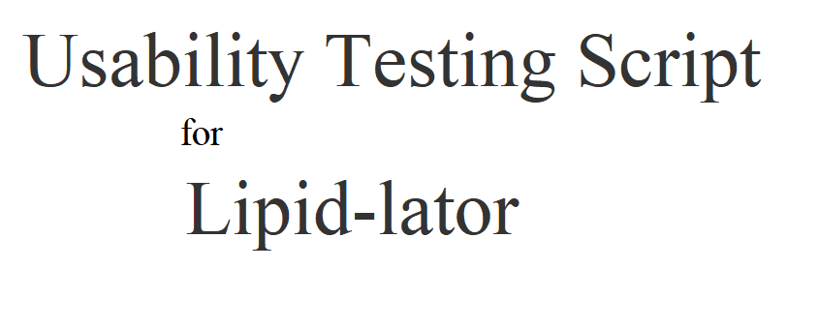
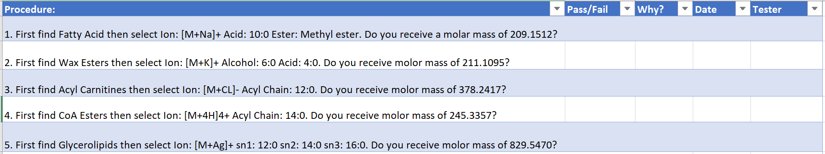
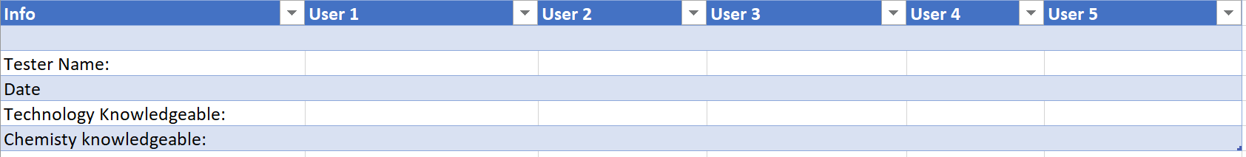

Slide 17
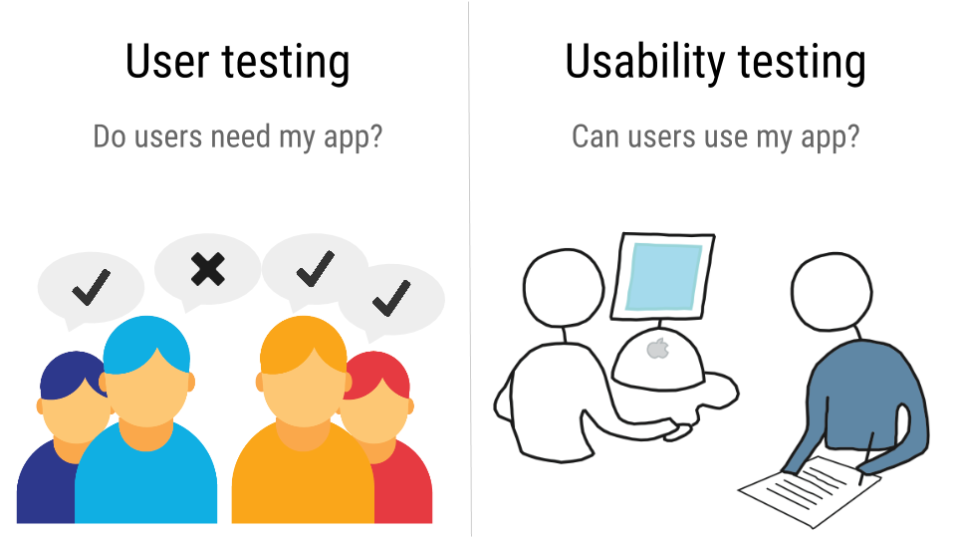
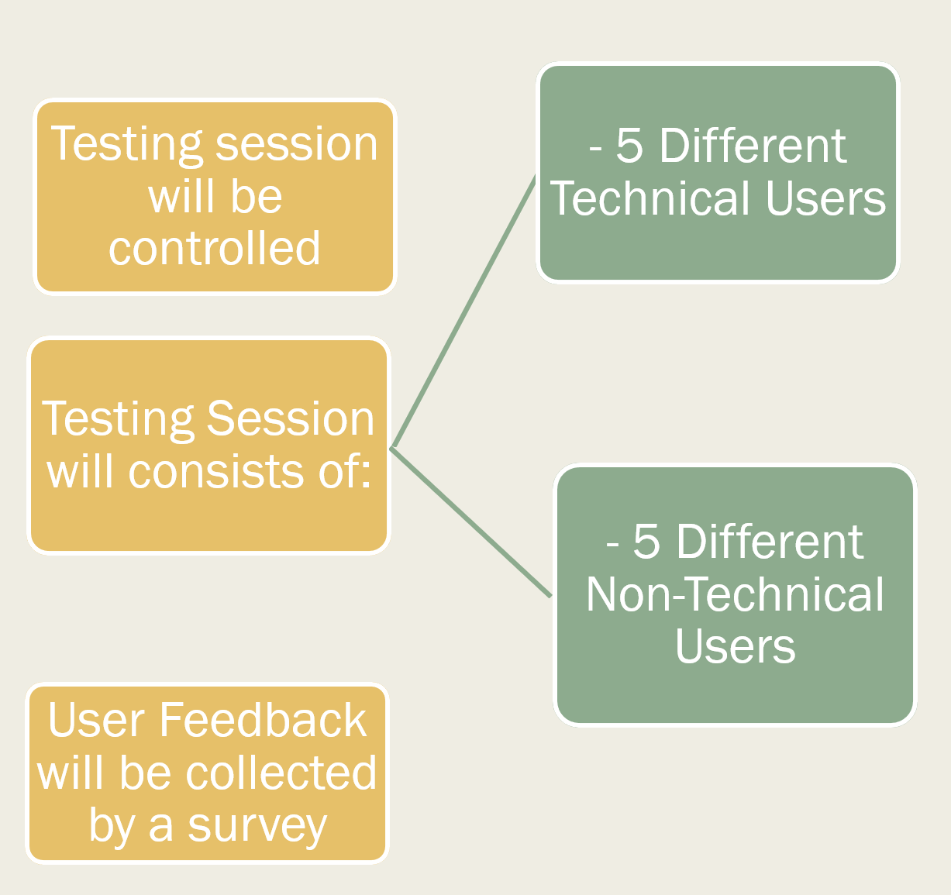
CREATE Event & User Testing Results and Actions Taken

Slide 18
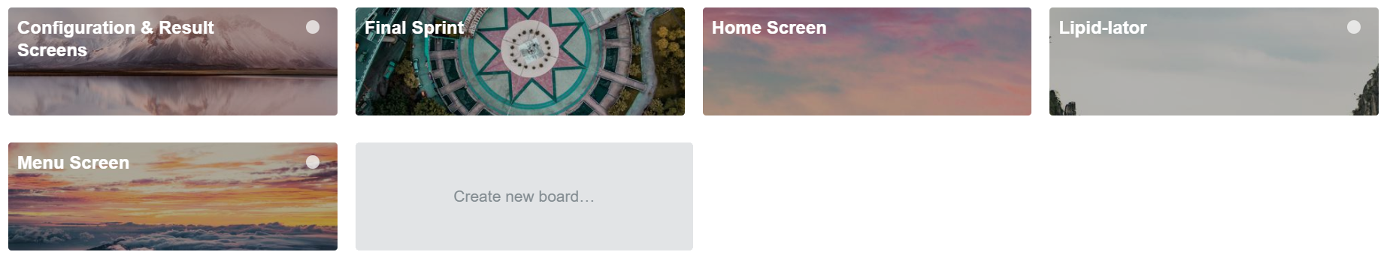
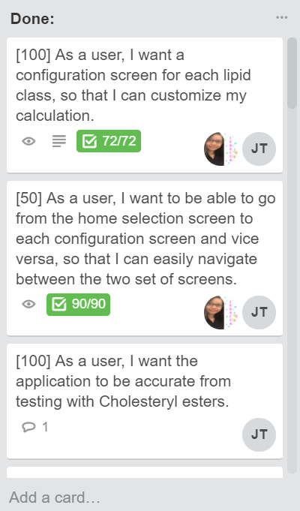
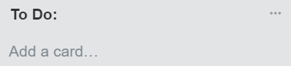
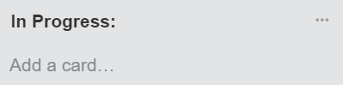
T
r
e
l
l
o

Slide 19
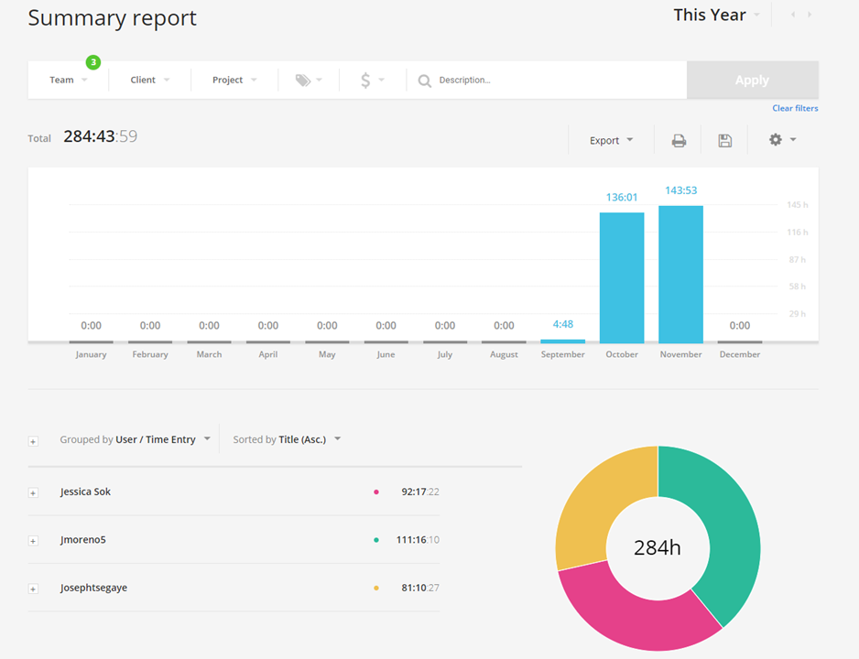

Slide 20
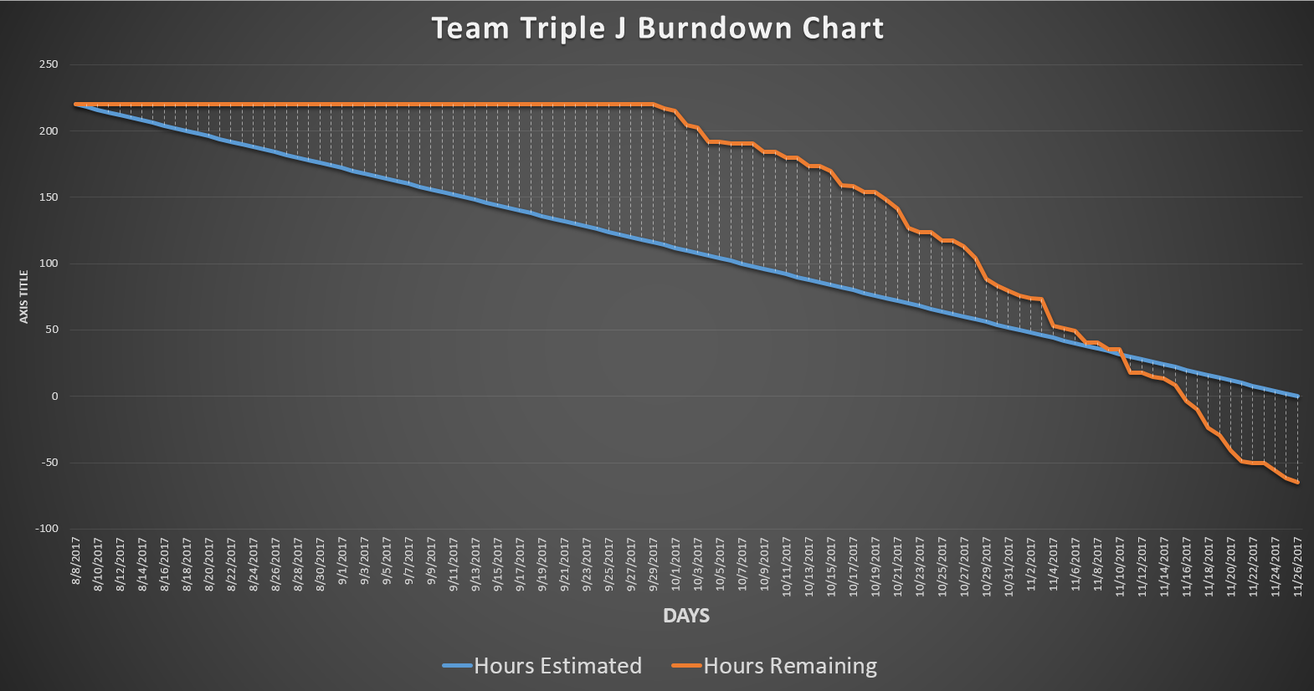
Estimated Hours
Hours Worked
Difference in Hours
220
285
-65

Slide 21
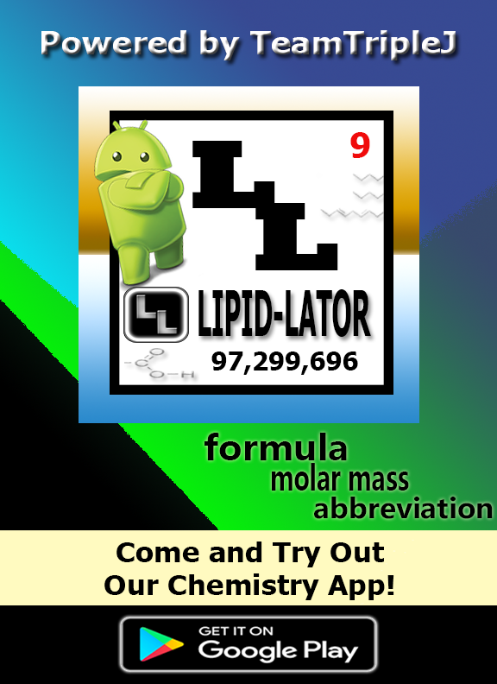
Plans for CREATE
Poster presentation
App demo on Android phones
QR code and mini flyers with Google Play download link
User testing survey
Sugar cookies for those who complete survey while supply lasts

Slide 22
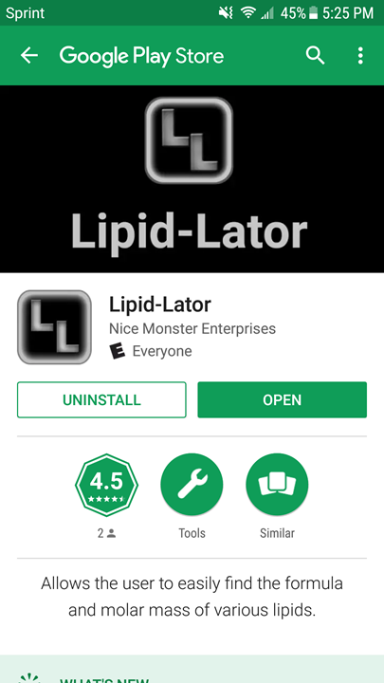
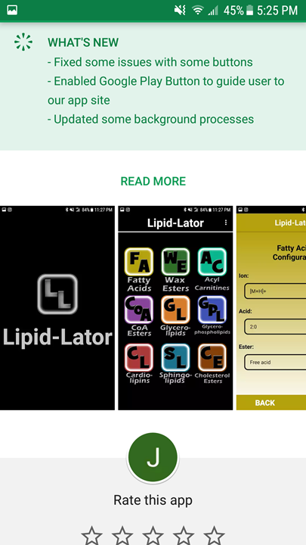
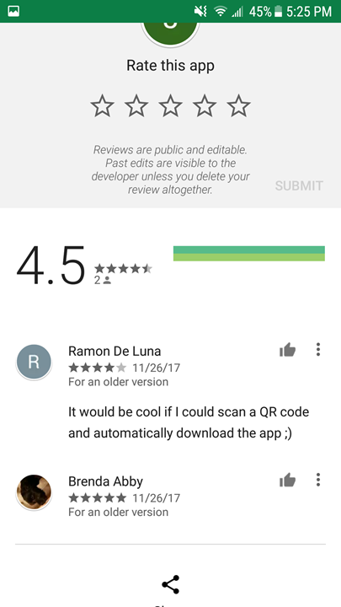

Slide 23
Extra Information
Visit our Github:
Documentations
Software usage license
Screenshots
Screencast
and much more…!

